Slide 1
Shotgun metagenomics
Dr. Natalia Zajac
Metagenomics, 12.2024

Slide 2
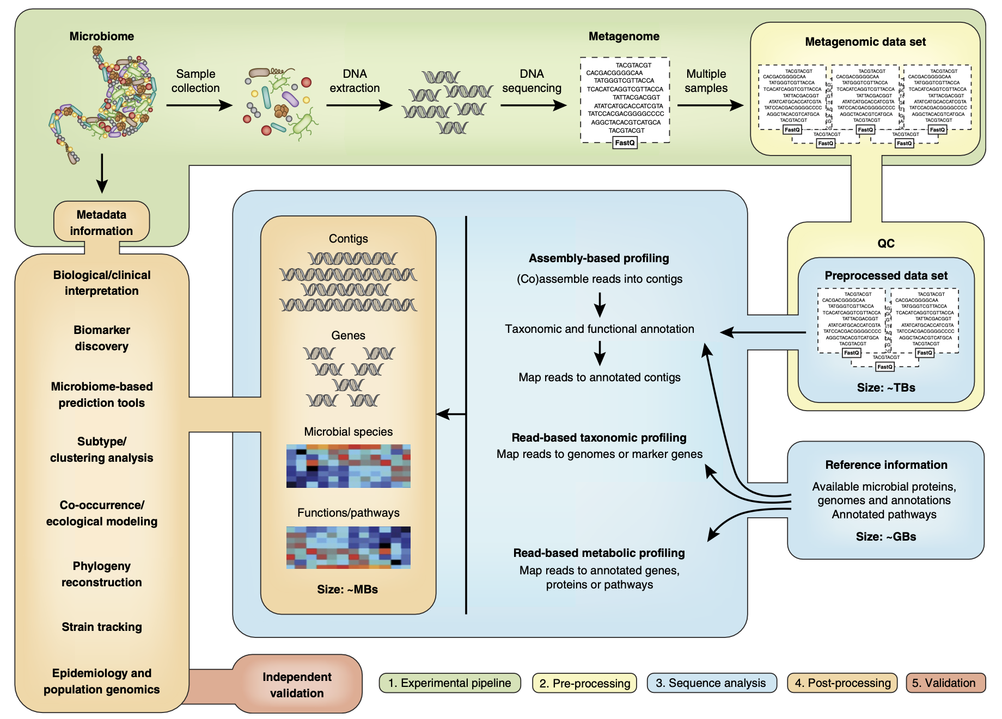
Overview
3. Metagenome assembly and annotation

Slide 3
Overview
3. Metagenome assembly and annotation

Slide 4
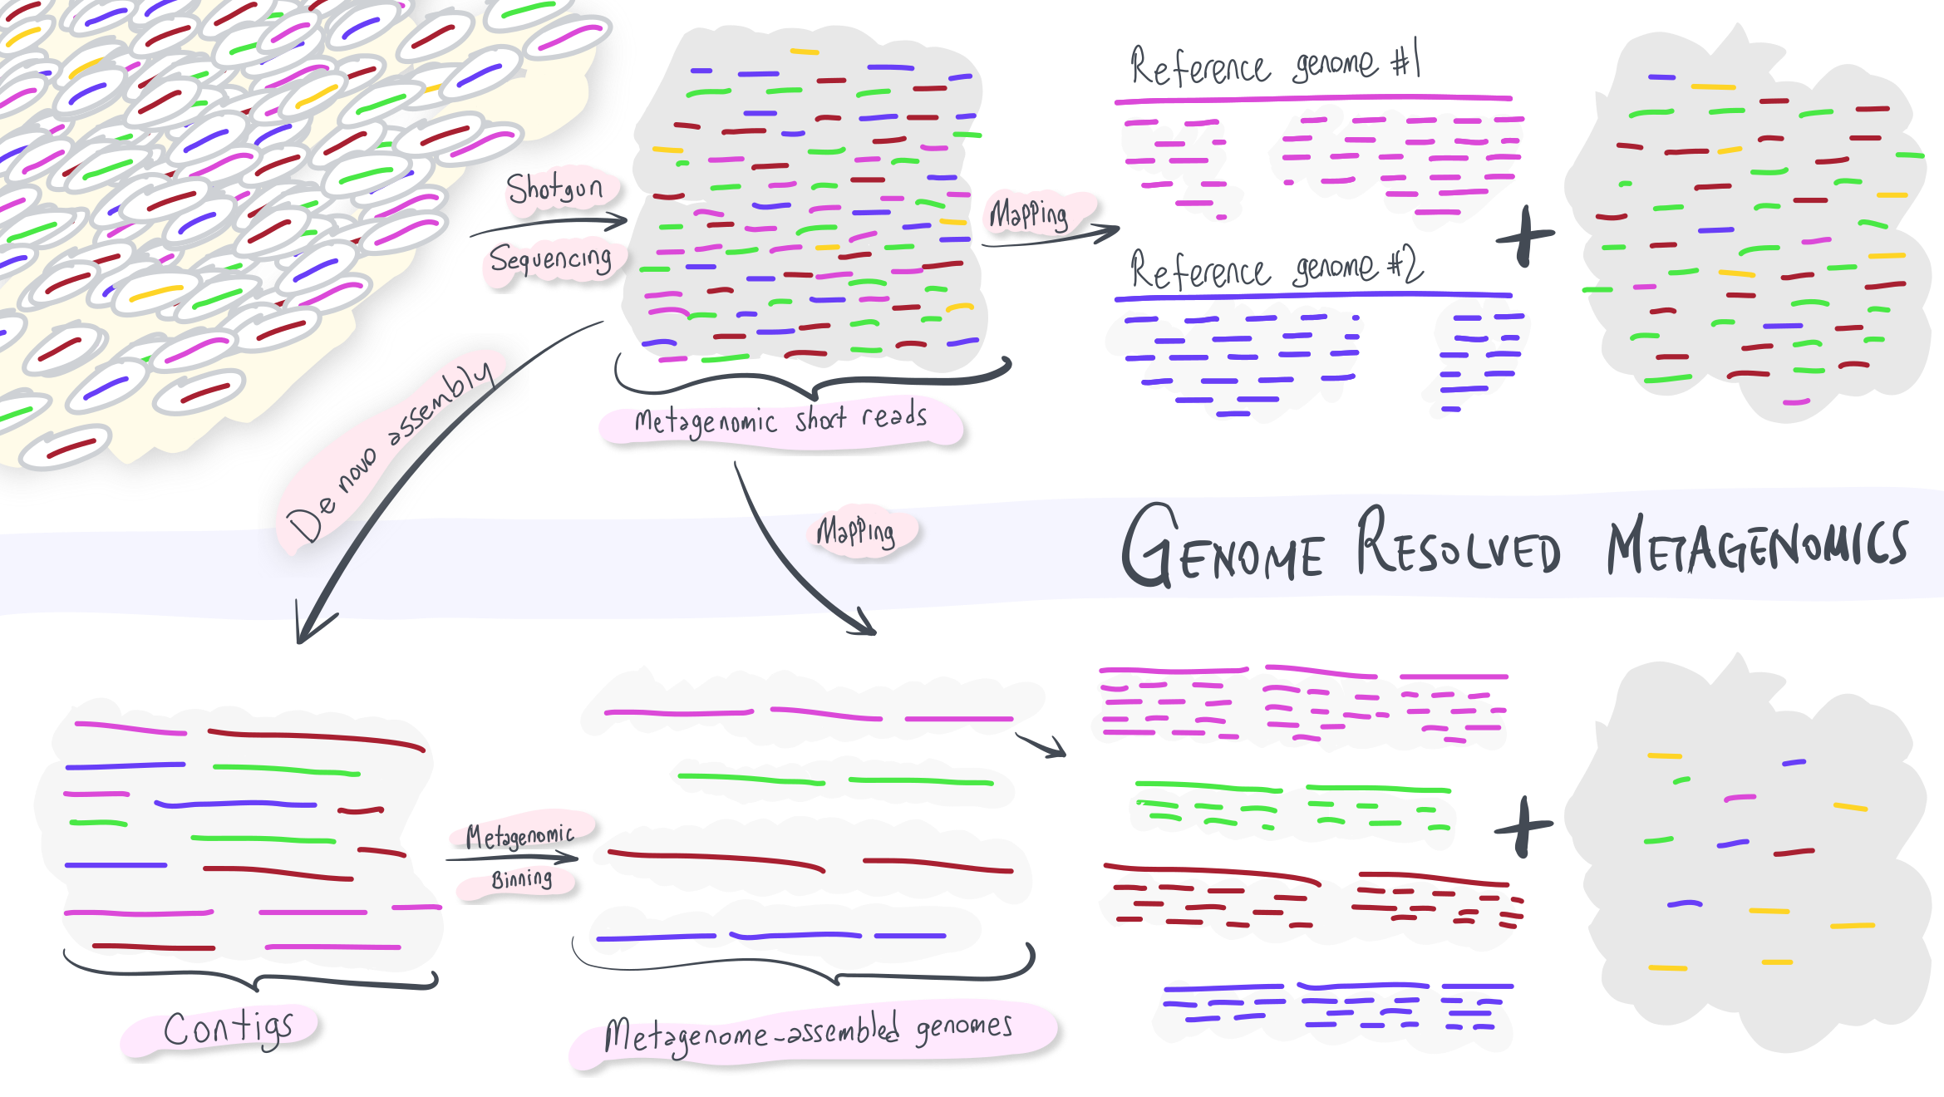
https://merenlab.org/momics/#genome-resolved-metagenomics
Notes:
In this case, we have better characterized the environment compared to the previous approach.
Q: Why are there still blue reads?
Q: What’s up with yellow? Which stage of the analysis may have failed?
Q: What else can we do to get the genome of yellow?

Slide 5

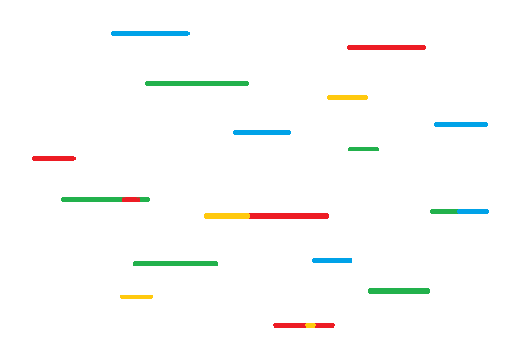
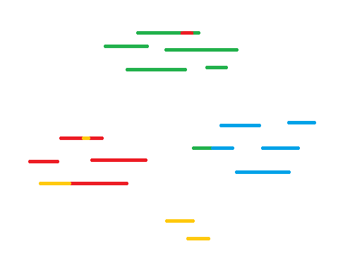
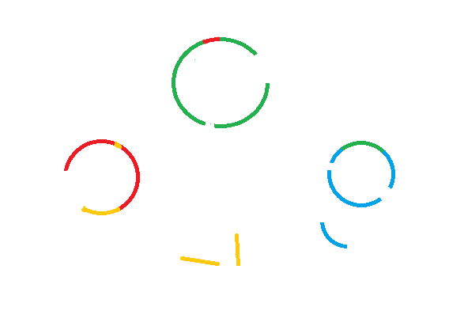
Structuring Metagenomic Studies: Types Of Metagenomic Assembly
Raw reads are derived from an ‘environmental sample’
All the contigs from the biome are assembled together
Contigs are binned into taxonomic groups
Contigs are further assembled to generate high quality genomes
Raw Reads
Primary Assembly
Binned Assembly
Metagenome-Assembled Genome (MAG)

Slide 6
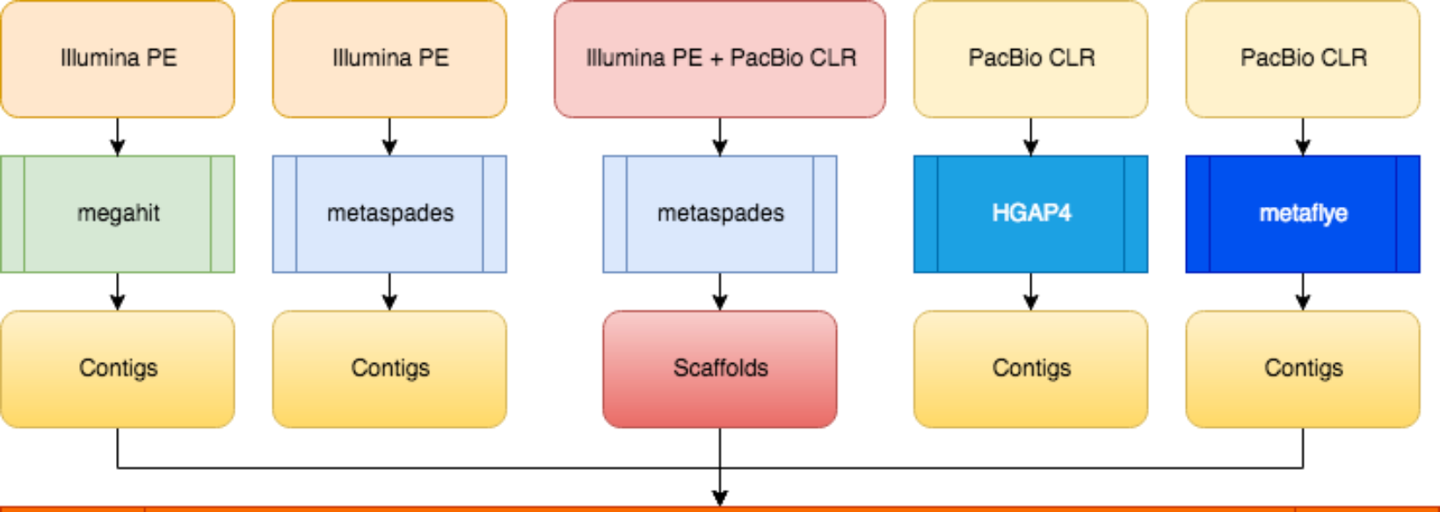
Metagenome assembly and binning workflow
PacBio Hifi
PacBio Hifi
hifiasm –meta/metaMDBG
HiCanu
Contigs
Contigs
MetaBat2 binning and CheckM QC

Slide 7
Structuring Metagenomic Studies: Types Of Metagenomic Assembly
Raw reads are derived from an ‘environmental sample’
All the contigs from the biome are assembled together
Contigs are binned into taxonomic groups
Contigs are further assembled to generate high quality genomes
Raw Reads
Primary Assembly
Binned Assembly
Metagenome-Assembled Genome (MAG)

Slide 8
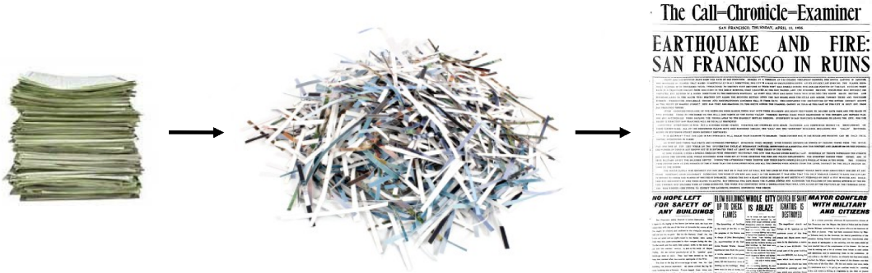
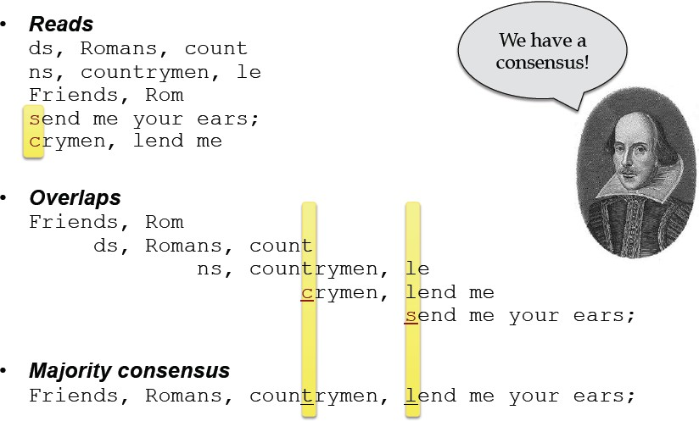
Assembly – The Problem
Overlap-Layout-Consensus
assembly algorithms
De Brujin graph
Dr. Torsten Seemann

Slide 9
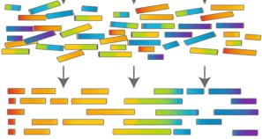
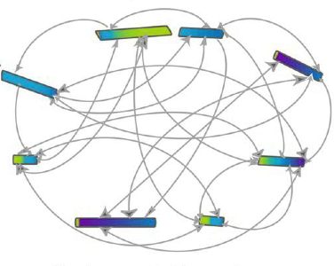
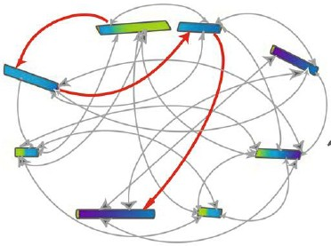
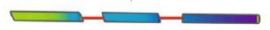
Overlap Layout Consensus - OLC
Overlap
Find all overlaps between reads
Build overlap graph: nodes=reads, edges=overlaps
Layout
Simplify graph: errors/SNPs, repeats
Define assembly path
Consensus
Align reads along assembly path
Consensus bases are called using weighted voting

Slide 10
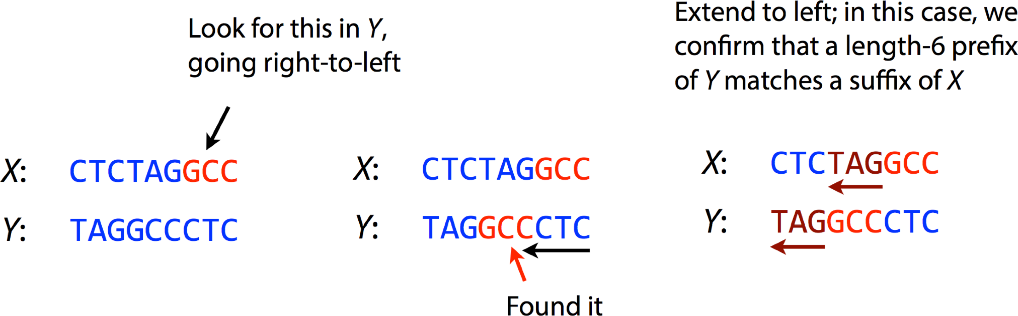
Overlap Layout Consensus - Overlap
Resulting overlap
CTCTAGGCCCTC
X
Y
We need to do this for every pair of reads
Overlapping is typically the slowest part of assembly
Consider a second-generation sequencing dataset with hundreds of millions or billions of reads!

Slide 11
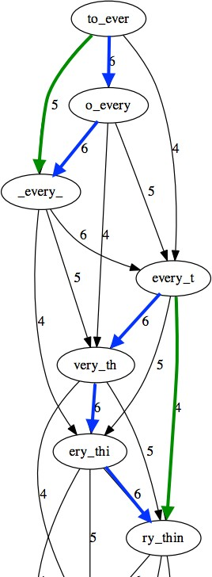
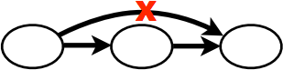
Overlap Layout Consensus - Layout
Pop bubbles
Bubbles are formed with transitively inferable edges
– Edges can be inferred from others
– The green ones can be inferred from the blue ones
Popping bubbles collapses small differences (i.e. minor heterozygosity)

Slide 12
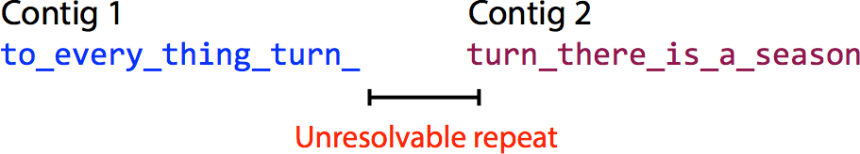
Overlap Layout Consensus - Layout
Transverse only unambiguous paths
Repeats, paralogous genes etc form ambiguous paths
Branches
Report only paths corresponding to non-branching stretches
Reliable stretches of unique DNA sequences
Leave ambiguous stretches unresolved

Slide 13
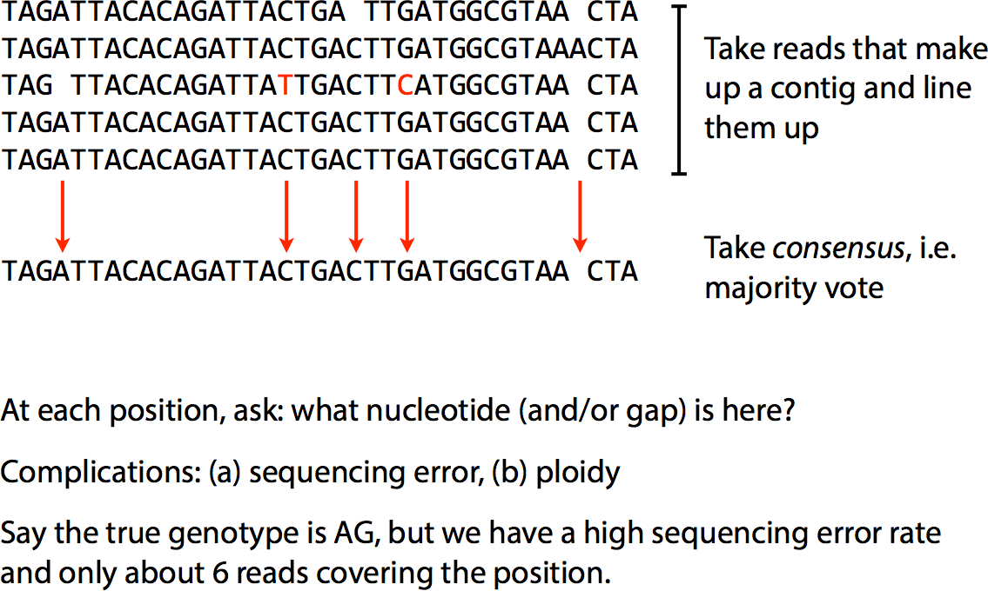
Overlap Layout Consensus - Consensus

Slide 14
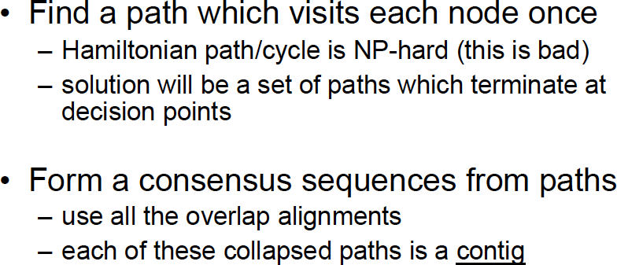
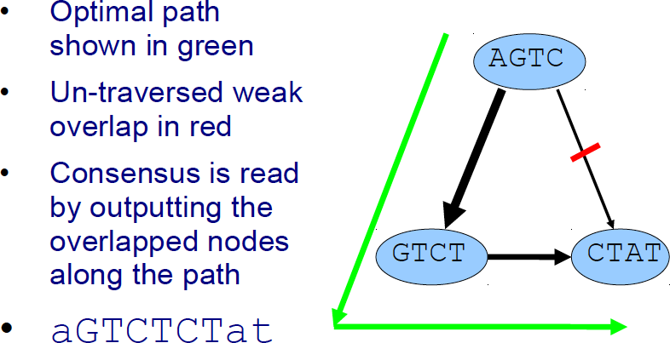
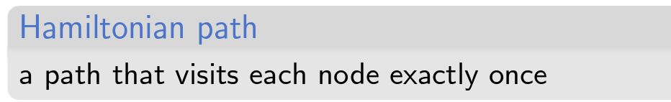
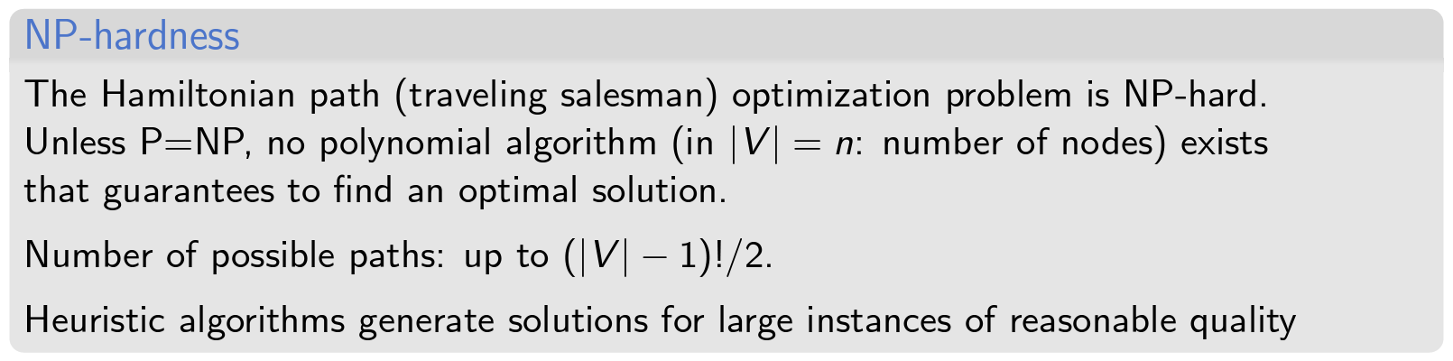
Overlap Layout Consensus – Example

Slide 15
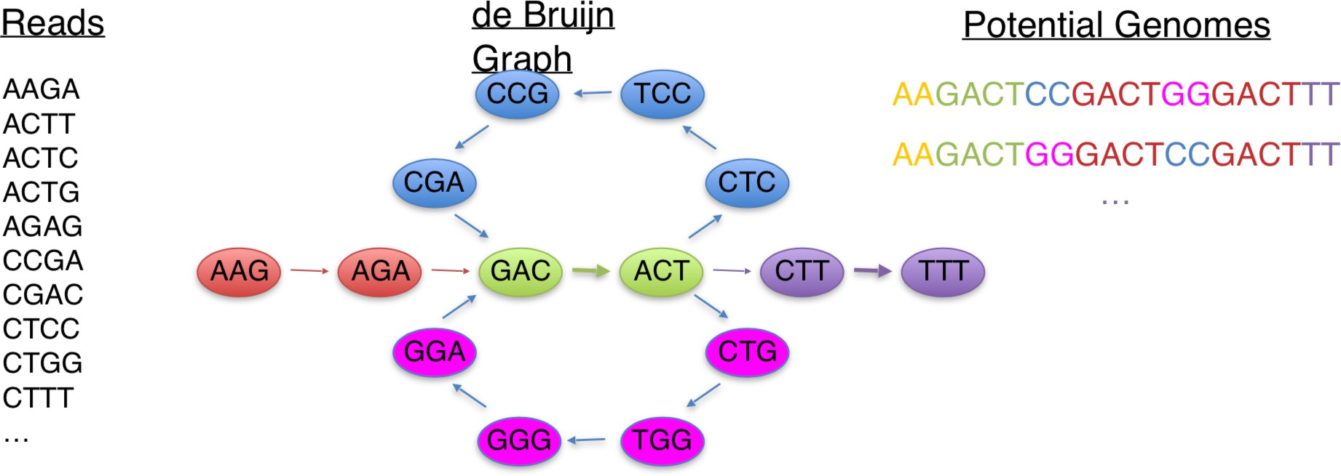
De Bruijn graph
De Brujin graph - DBG
Reads are split into K-mers (sequences of length K)
K-mers represent the edges of the graph
The nodes are the suffix and the prefix of length K-1 shared by edges
The assembly is an Eulerian path (it contains all the edges)
A directed, connected graph is Eulerian if and only if it has at most 2 semi-balanced nodes and all other nodes are balanced

Slide 16
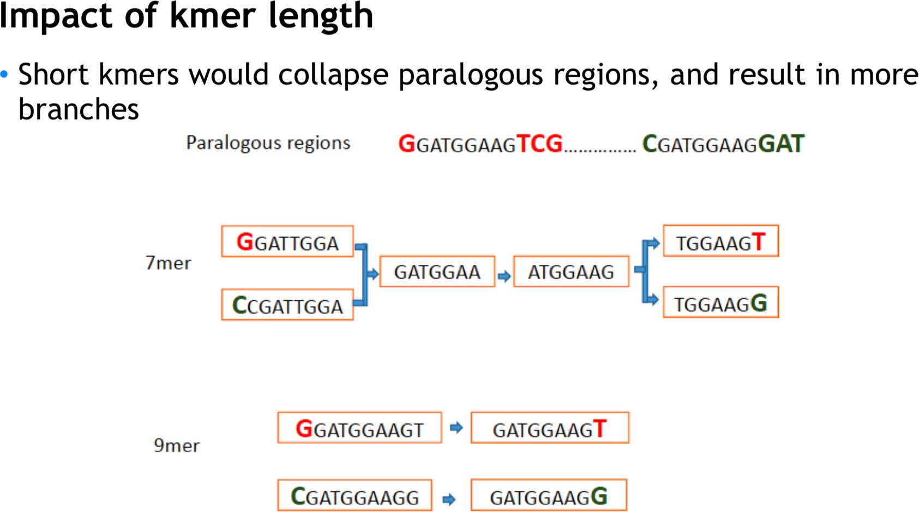
De Brujin graph - DBG

Slide 17
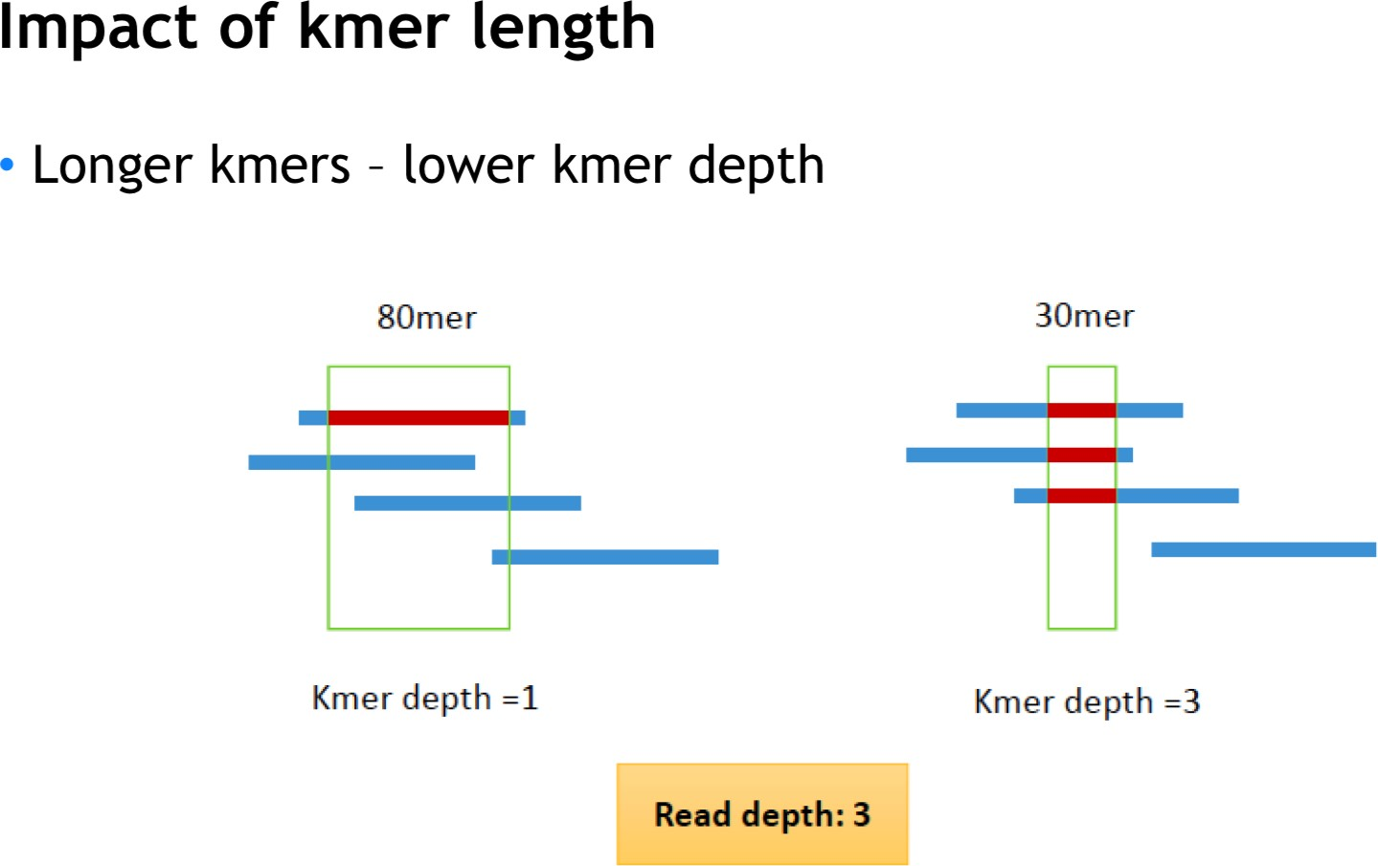
De Brujin graph - DBG
A selection of k-mers is always used to get the optimal assembly.
Megahit and Metaspades are DBG assemblers.
Optimal k-mer length has to be chosen for low- and high- abundance species

Slide 18
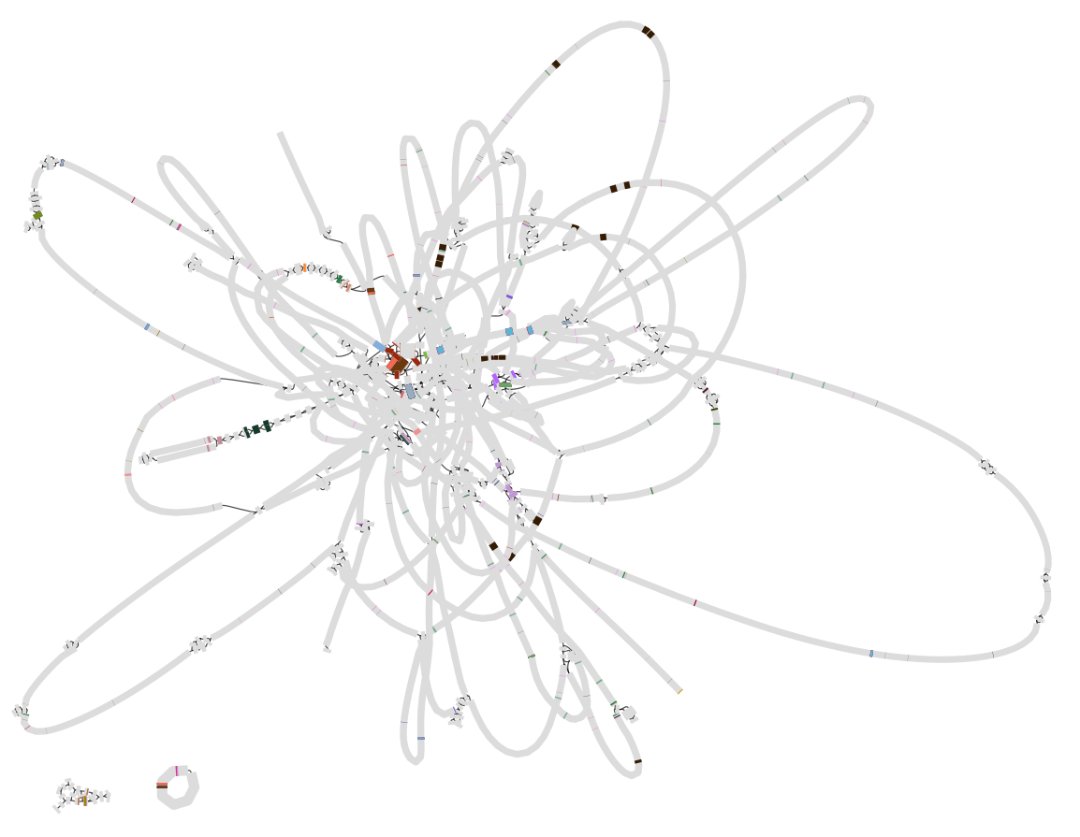
De Brujin graph – Visualising assembly graph
Tools such as metaSPAdes convert the de Bruijn graph to an assembly graph
Bandage allows the visualisation and querying of this graph

Slide 19
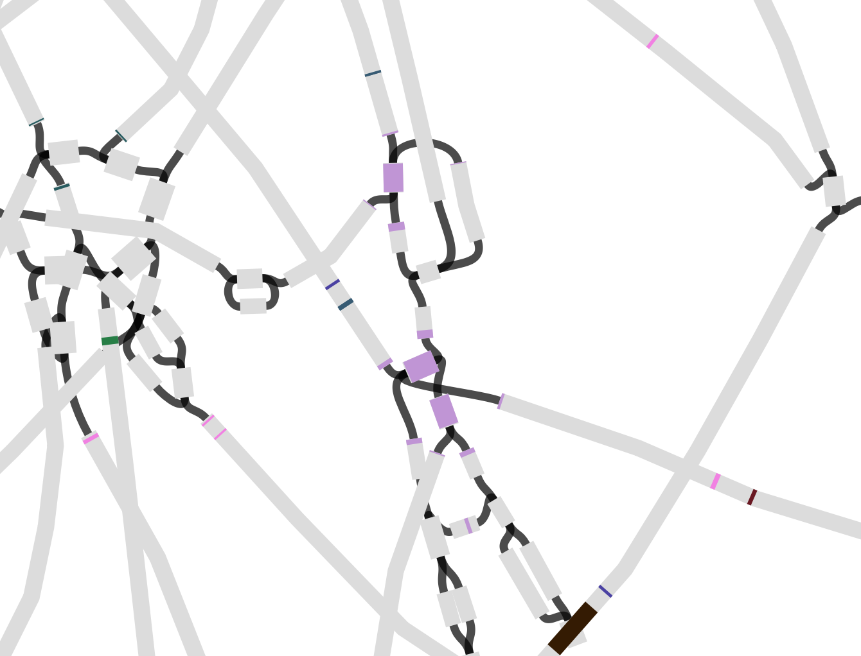
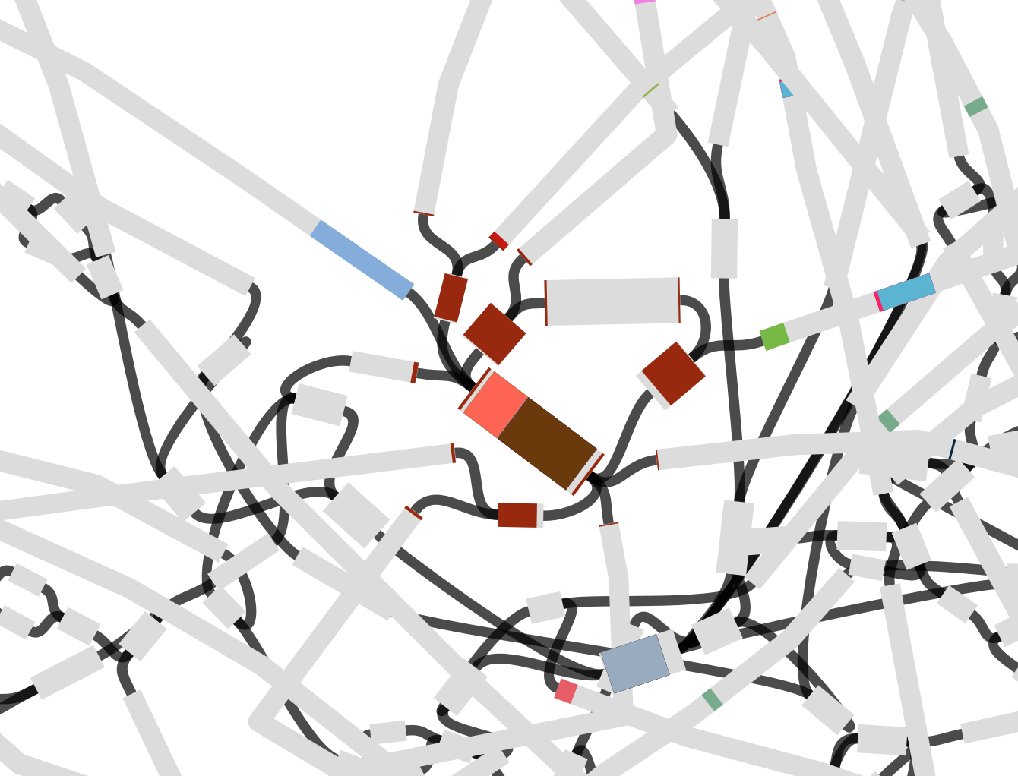
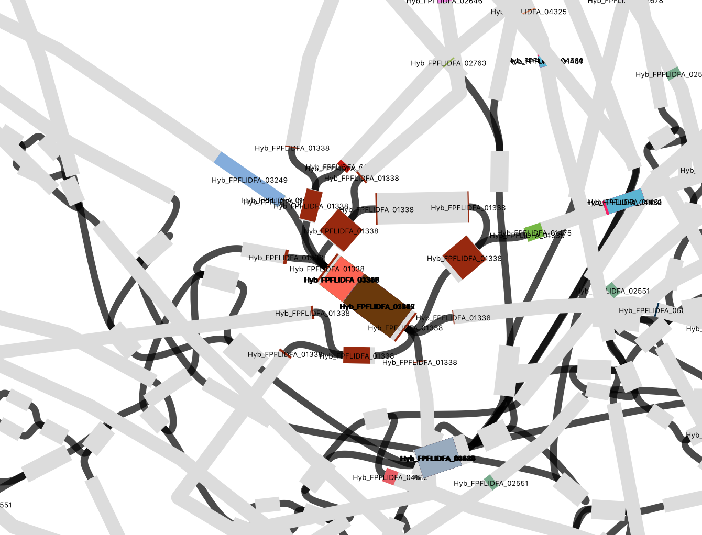
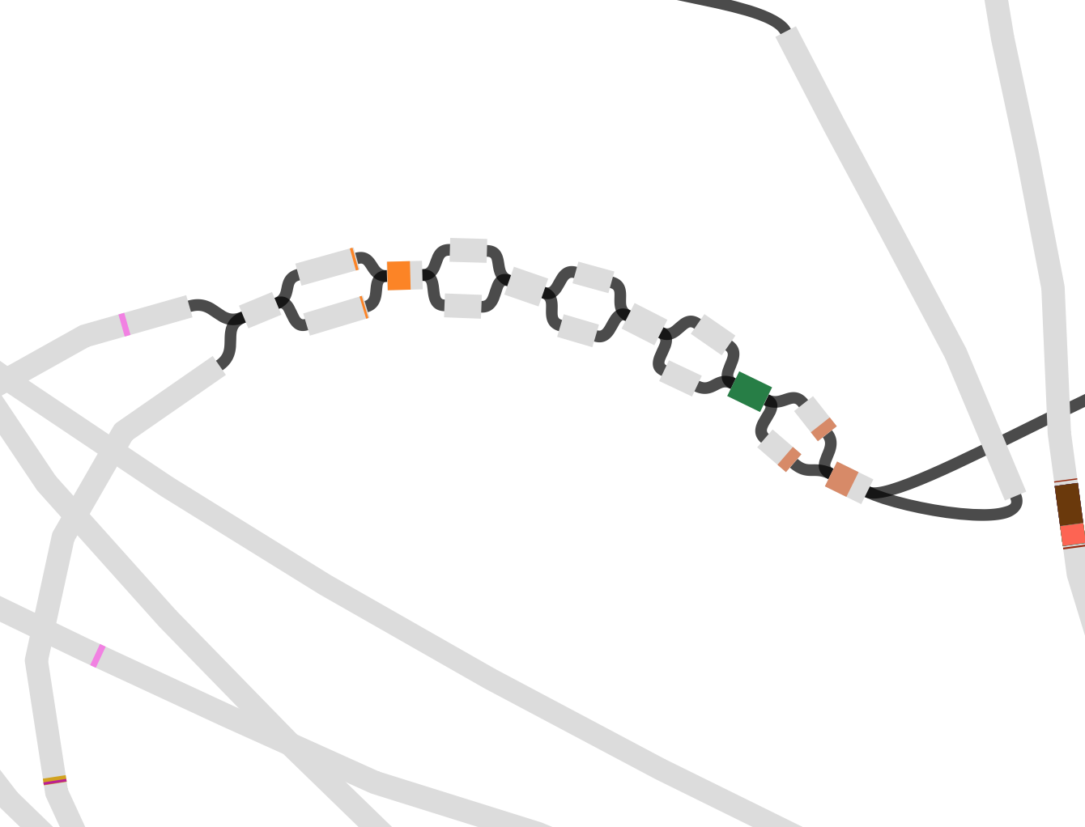
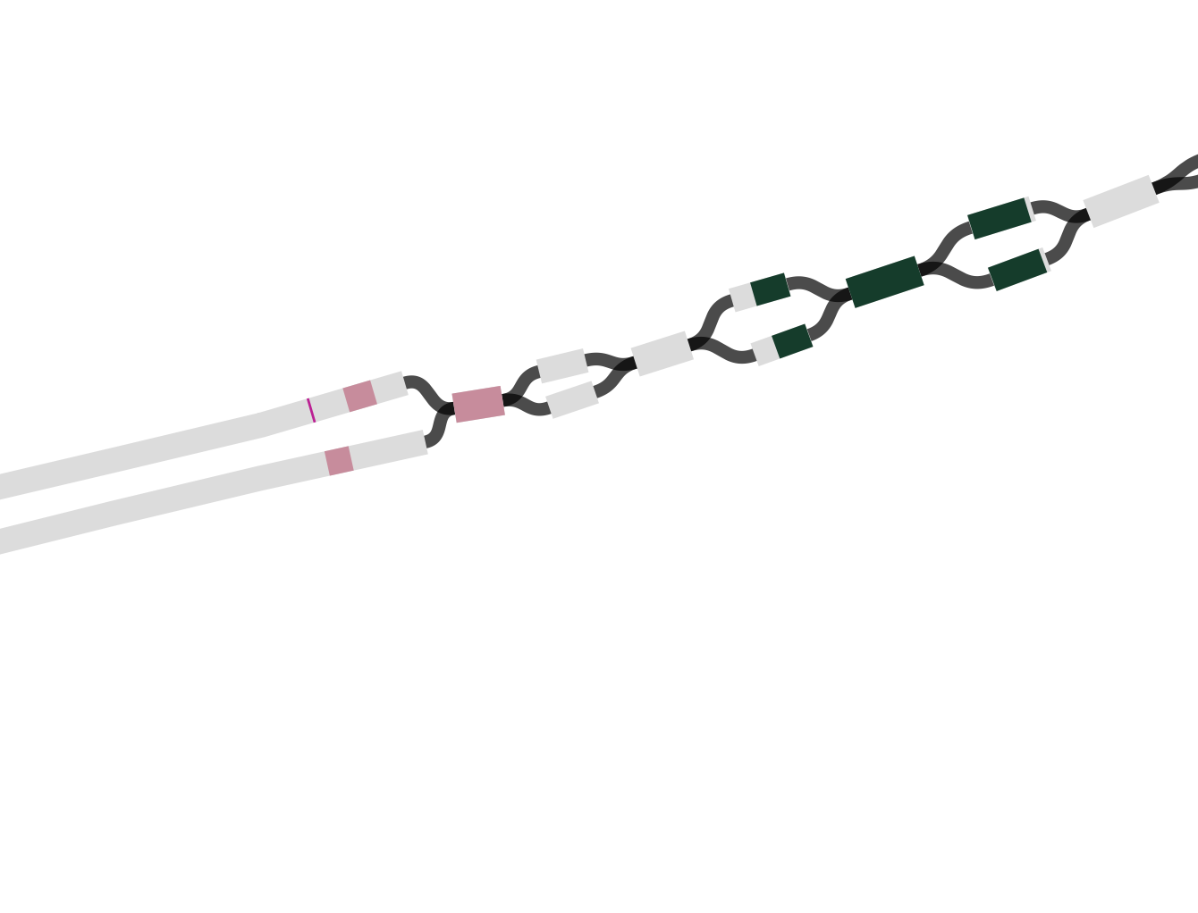
Width of edges proportional to read coverage
Some examples of multiple possible contiguity in which lost proteins are involved.
Conserved domains have multiple matches.

Slide 20
Computational resources limiting assemblies

Slide 21
Complications in assemblies
Different abundance
Highly abundant genomes are over-sequenced
- higher coverage repeats
Low abundant genomes – low coverage kmers are real
Different relatedness
Unique but highly conserved regions in a single genome might be repetitive in a metagenome
Simple coverage statistics can no longer be used to detect the repeats
Distinguishing true biological differences from sequencing errors becomes nearly impossible
Ghurye JS. 2016. Yale J Biol Med.

Slide 22
Structuring Metagenomic Studies: Binning contigs
Raw reads are derived from an ‘environmental sample’
All the contigs from the biome are assembled together
Contigs are binned into taxonomic groups
Contigs are further assembled to generate high quality genomes
Raw Reads
Primary Assembly
Binned Assembly
Metagenome-Assembled Genome (MAG)

Slide 23
Binning contigs: Two ways
Taxonomy-independent binning – unsupervised approach
Taxonomy-dependent binning – supervised approach

Slide 24
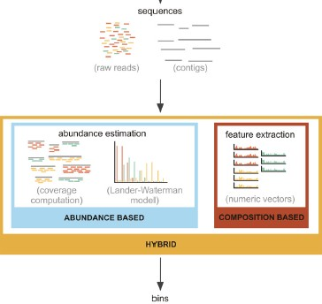
Binning contigs: Taxonomy-independent binning
Composition-based
Assumes nucleotide composition as closest proxy for species similarity - based on an assumption that the genome composition is unique for each taxon
Can also be reference agnostic, no assembly
Only reads information (e.g., GC %, K- mers)
Fast (no need to align)
Abundance-based
Assumes sequence abundances as closest proxy for species similarity
De novo assembly for initial contigs
Abundance of contigs via read mapping
Binning of contigs
Concerned with k-mer abudance rather than conent
Lander-Waterman model - coverage of each nucleotide can be computed by the application of the Poisson distribution

Slide 25
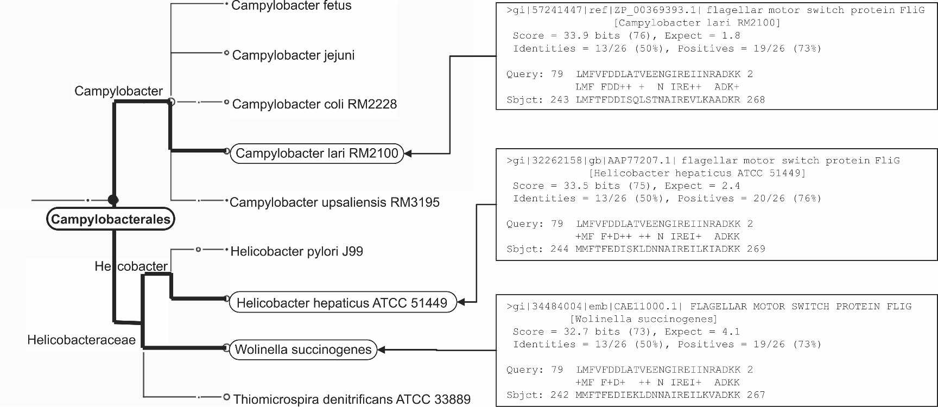
Taxonomy dependent binning (LCA)
Sequence-based
Assumes similarity to sequences in a database as closest proxy for species similarity
Multiple potential hits usually reported (30-50)
Lowest common ancestors approach (LCA) to resolve ambiguities
Standard LCA limited in the case of long/multiple ORF contigs (e.g., Eukaryote metagenomes)
LCA* recently proposed (Hanson et al., Bioinformatics 2016)
Huson et al., Gen. Res., 2007

Slide 26
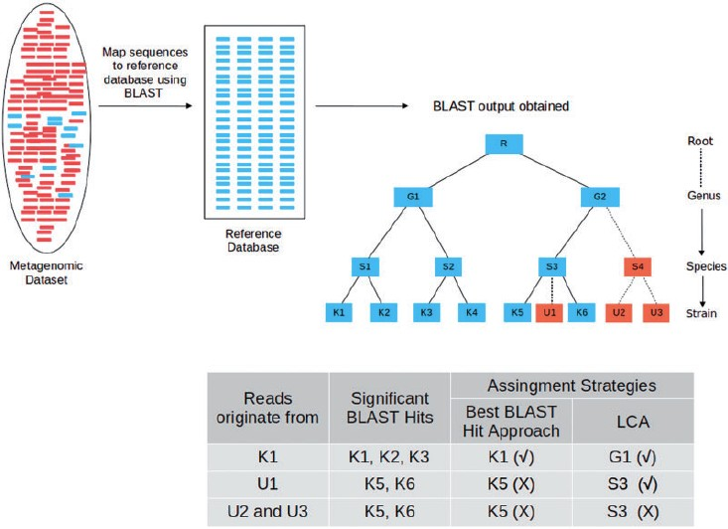
Taxonomy dependent binning (LCA)
PRO
CONS
Computationally intensive/time consuming (alignment and eventual downstream assembly)
Leveraging existing information
Amenable to shorter reads
Matching bit-scores sometimes inadequate metric
Rare microorganisms identifiable provided sufficient coverage
Problematic with sample from mostly unexplored environments

Slide 27
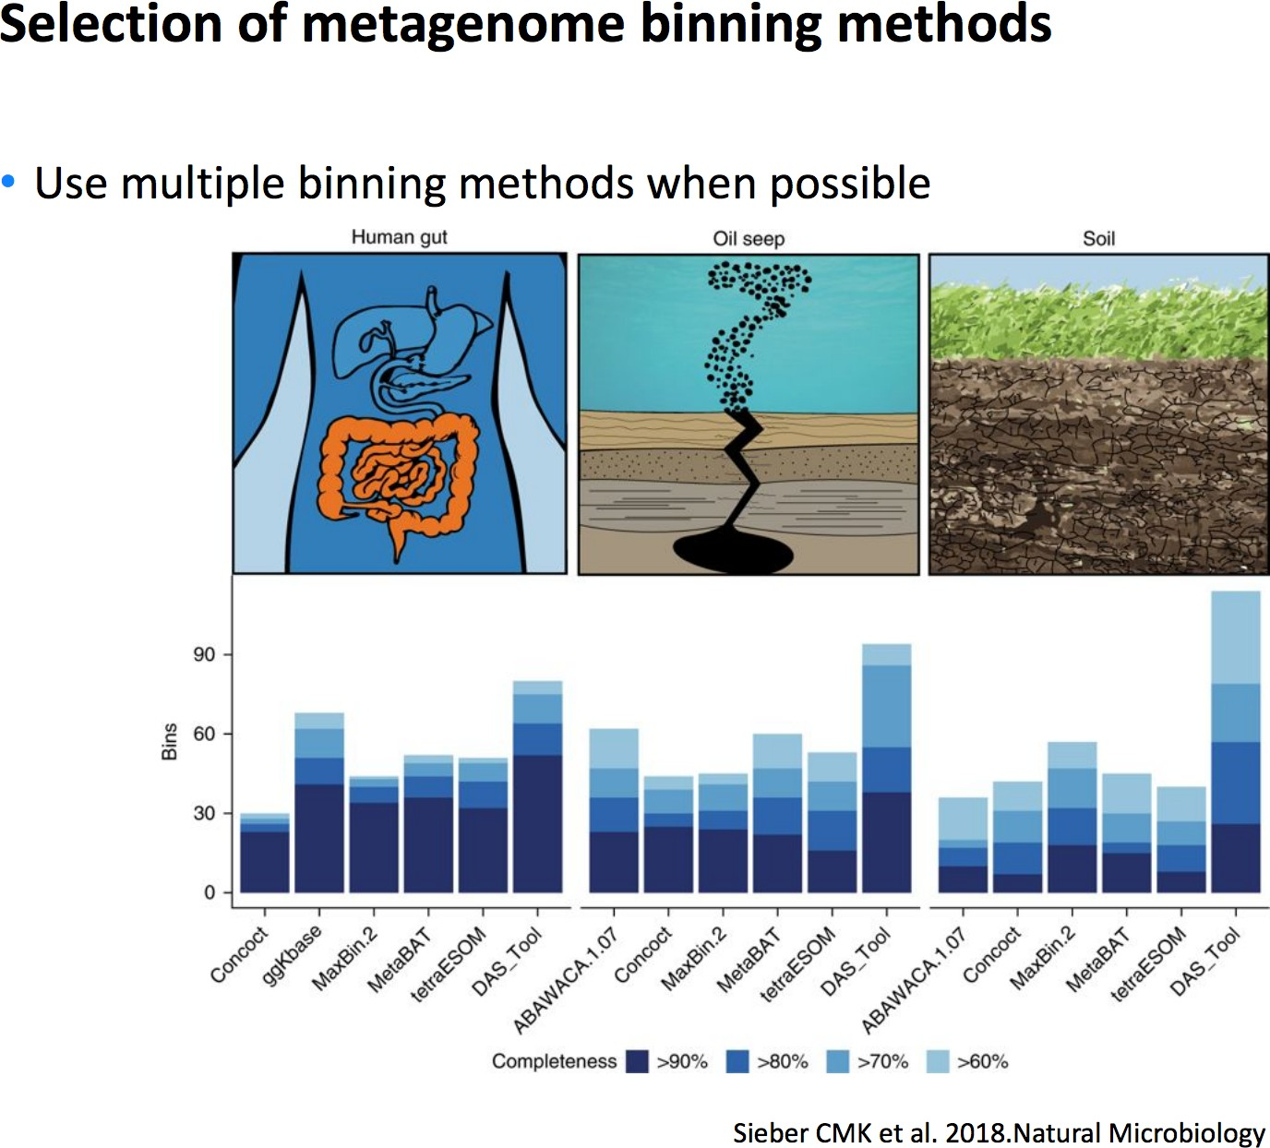
Binning contigs: Selection of methods

Slide 28
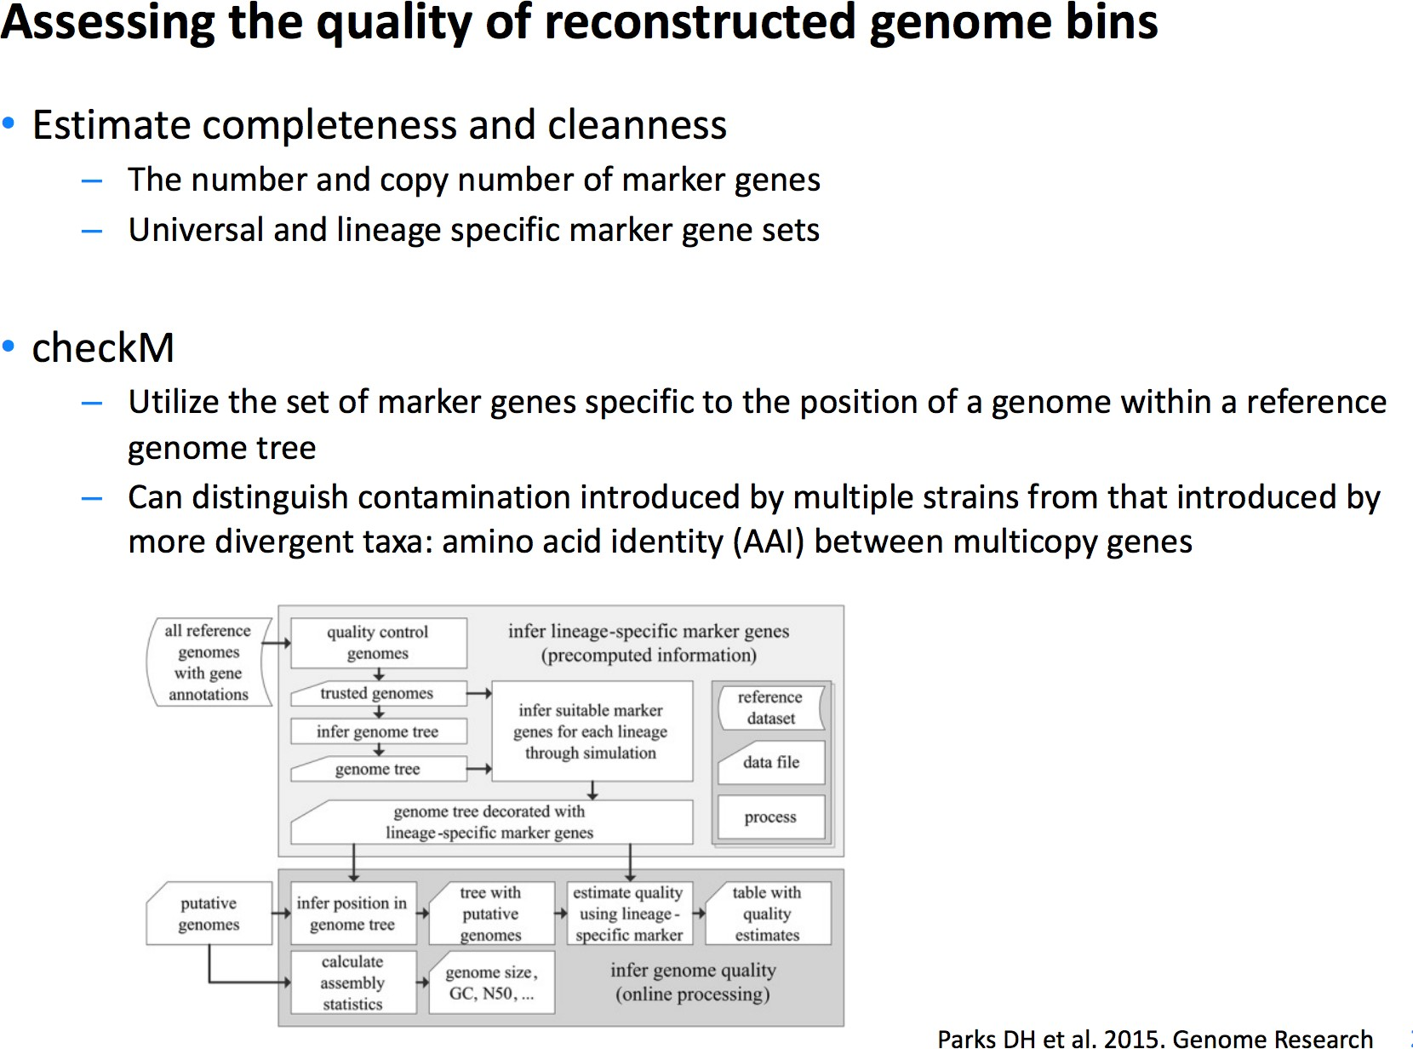
Binning contigs
a gene identified as single copy in ≥97% of genomes is considered to be a marker gene
often encode essential functions and are frequently organized into operons
often also used collocated marker sets

Slide 29
Binning contigs: Assessing quality with CheckM
Creating a CheckM database
Assesing your bins against the database

Slide 30
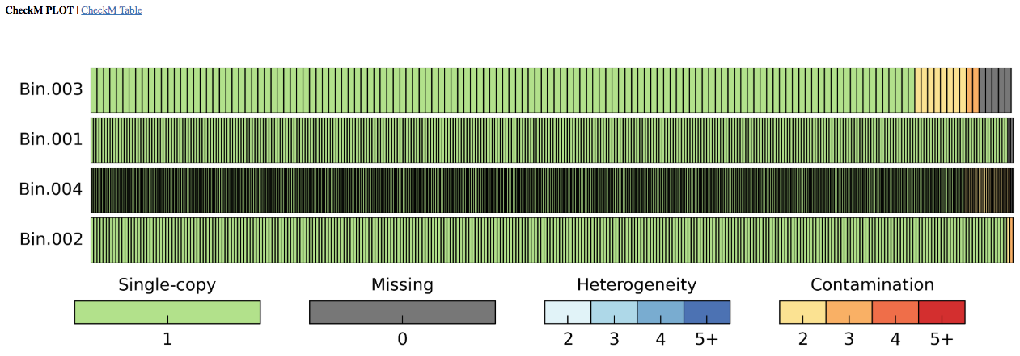
Binning contigs: Assessing quality with CheckM

Slide 31
What makes a good binned assembly
N50
minimum contig length that contains 50% of the assembled bases
Long contigs (subjective)
Does the assembly contain what you expect
MetaQUAST, BLAST
Assembly Likelihood Evaluation framework (ALE) - https://bioinformaticshome.com/tools/wga/descriptions/ALE-Assembly.html
tool can be used to detect errors in metagenomes as well by pinpointing single base errors, indels, genome re-arrangement and chimera
without the need of a reference genome
Notes:
If all contigs in an assembly are ordered by length, the N50 is the minimum length of contigs that contains 50% of the assembled bases. For example, an N50 of 10 000 bp means that 50% of the assembled bases are contained in contigs of at least 10000 bp

Slide 32
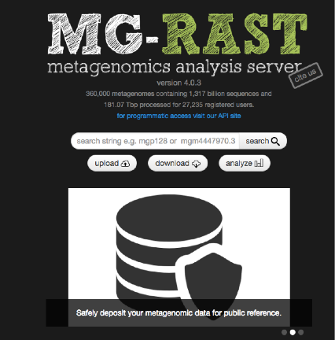
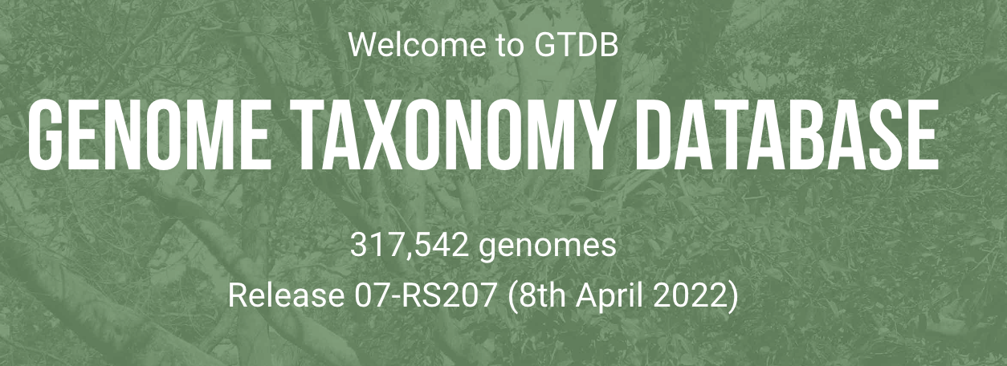
Tools for robust taxonomic classification
MG-RAST (GenBank annotation)
(https://www.mg-rast.org/)
GTDBTk
(https://github.com/Ecogenomics/GTDBTk) (https://gtdb.ecogenomic.org/)

Slide 33
Overview
3. Metagenome assembly and annotation

Slide 34
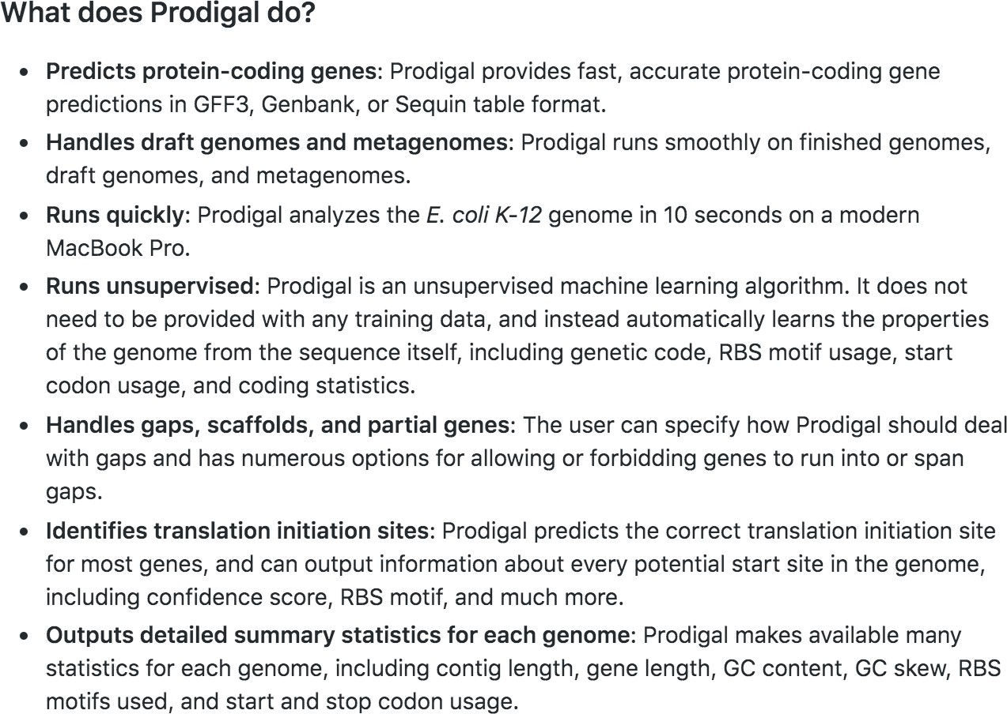
Protein prediction: Prodigal

Slide 35
Protein prediction: Prokka
Prokka trustworthy databases, moving from medium-sized to domain-specific databases in a hierarchical manner.
An optional user-provided set of annotated proteins. These are expected to be trustworthy curated datasets and will be used as the primary source of annotation. They are searched using BLAST+ blastp ( Camacho et al. , 2009 ).
All bacterial proteins in UniProt ( Apweiler et al. , 2004 ) that have real protein or transcript evidence and are not a fragment. This is ∼16 000 proteins, and typically covers >50% of the core genes in most genomes. BLAST+ is used for the search.
All proteins from finished bacterial genomes in RefSeq for a specified genus. This captures domain-specific naming, and the databases vary in size and quality, depending on the popularity of the genus. BLAST+ is used for this and is optional.
A series of hidden Markov model profile databases, including Pfam ( Punta et al. , 2012 ) and TIGRFAMs ( Haft et al. , 2013 ). This is performed using hmmscan from the HMMER 3.1 package ( Eddy, 2011 ).
If no matches can be found, label as ‘hypothetical protein’.

Slide 36
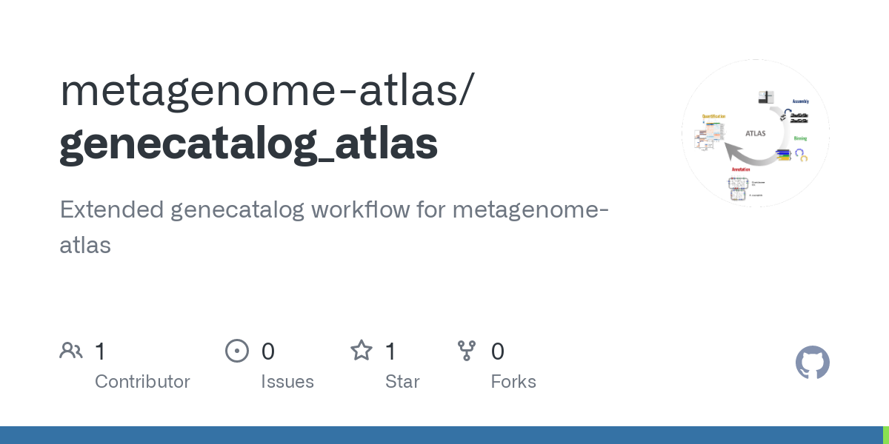
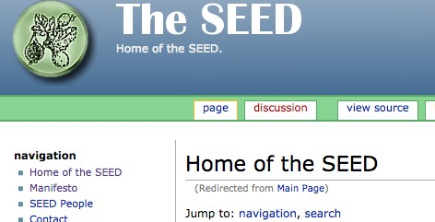
Annotation
After binning/reads assembly (preferred)
Large contigs (30,000+ bp) expected to have optimal results
Genome annotation tools used quite successfully
A lot of pipelines do it automatically as a next step of the workflow:

Slide 37
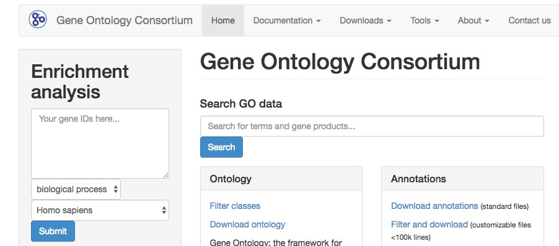
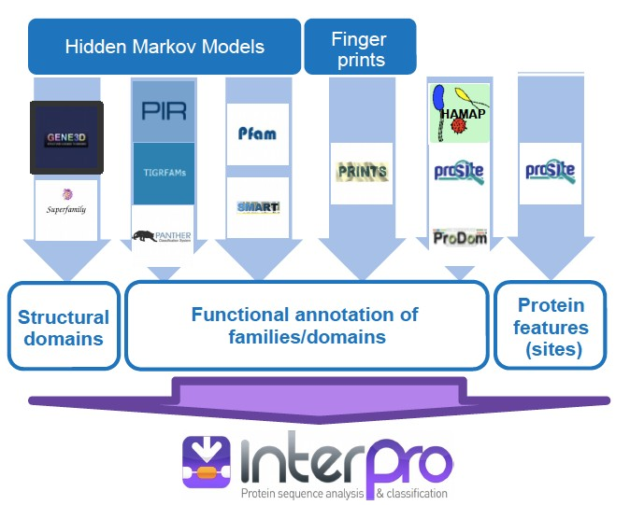
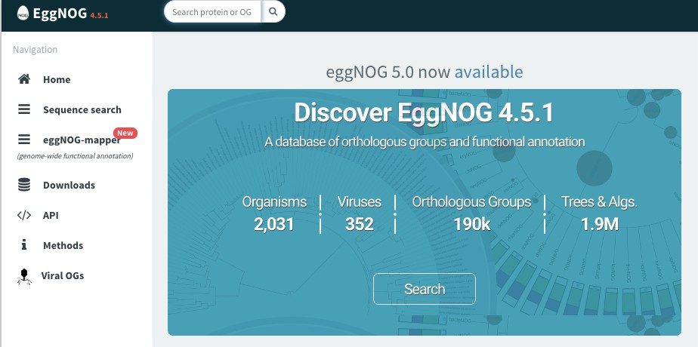

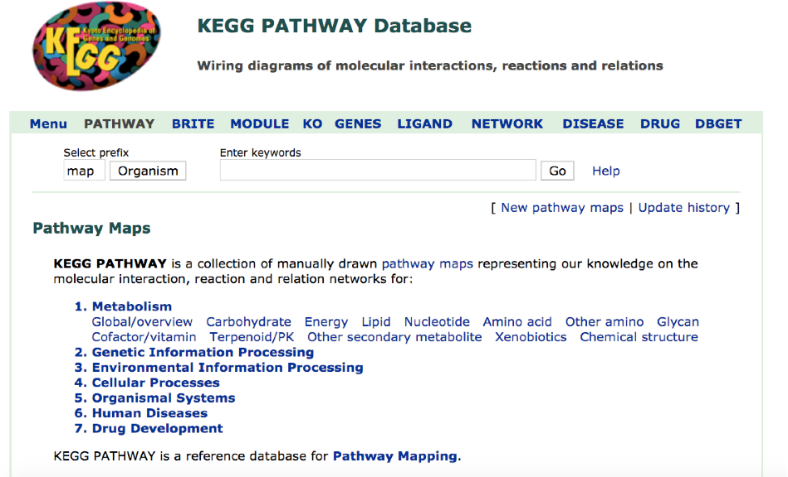
Annotation
Orthology based gene funtion prediction (EggNOG, GO Consotrium, OMA GO annotation, Pannzer2)
Annotation of protein domains (Interpro scan)
Metabolic pathway prediction (KEGG)

Slide 38

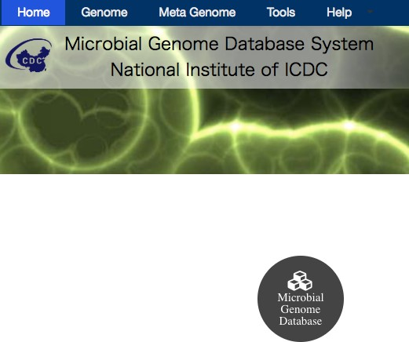
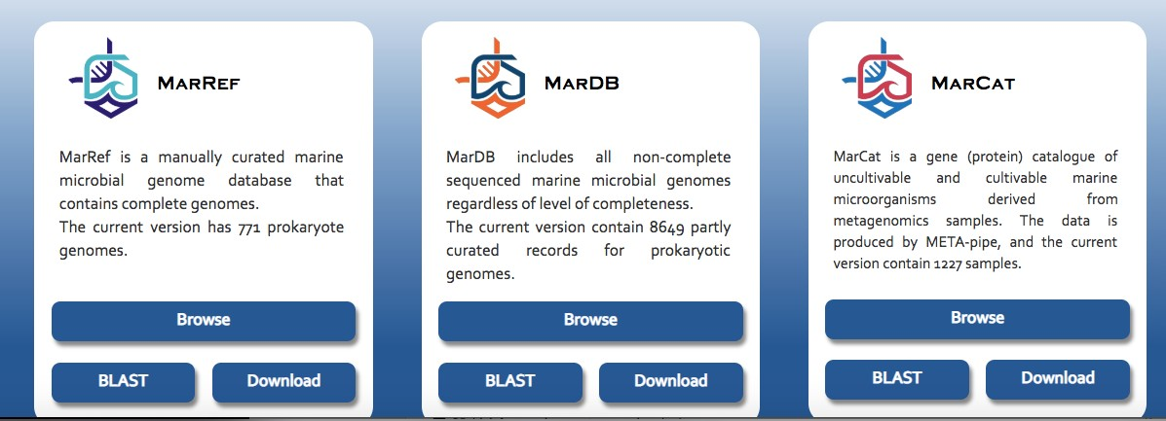
Using ecosystem-specific databases for annotation and taxonomy
Annotation

Slide 39
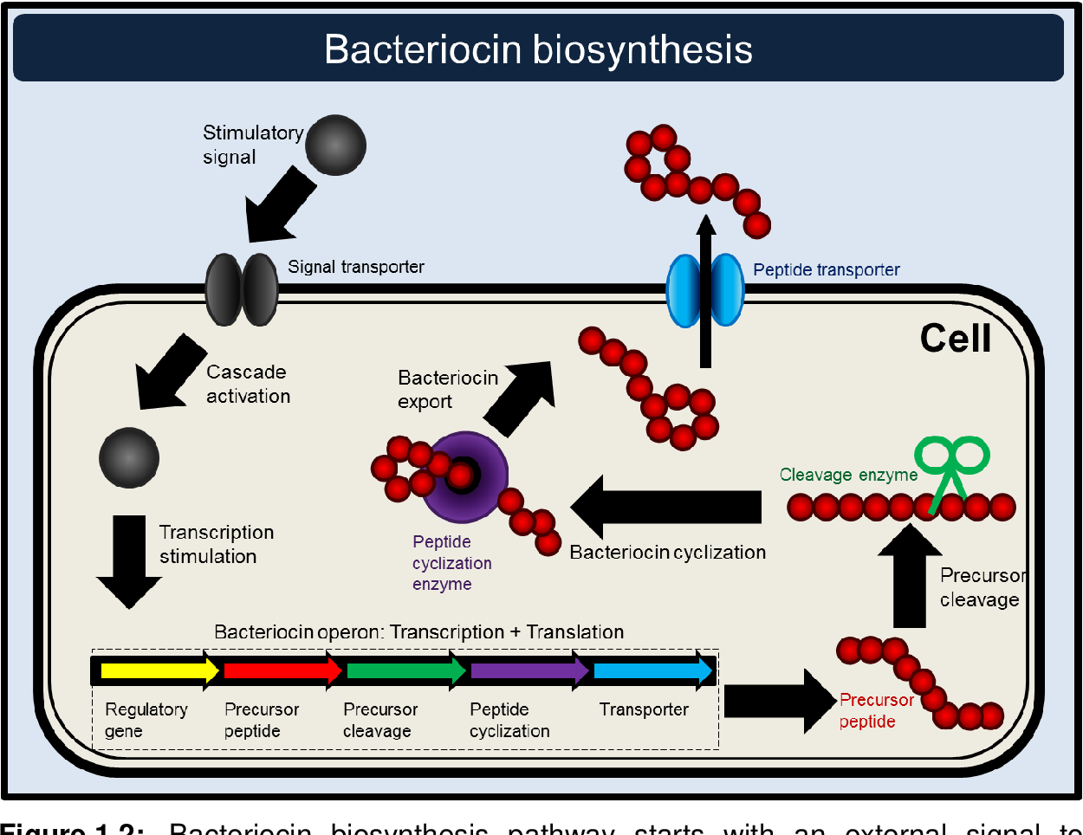
Biosynthetic Gene Clusters
Annotation
Biosynthetic gene clusters (BGCs) are a locally clustered group of two or more genes that together encode a biosynthetic pathway for the production of a secondary metabolite.
Classes of BGCs:
peptide synthetases (NRPS)
polyketide synthases (PKS)
bacteriocins

Slide 40



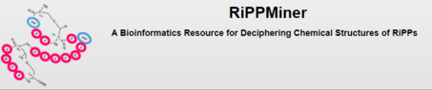
Biosynthetic Gene Clusters
Annotation
Biosynthetic gene clusters (BGCs) are a locally clustered group of two or more genes that together encode a biosynthetic pathway for the production of a secondary metabolite.
Classes of BGCs:
peptide synthetases (NRPS)
polyketide synthases (PKS)
bacteriocins

Slide 41
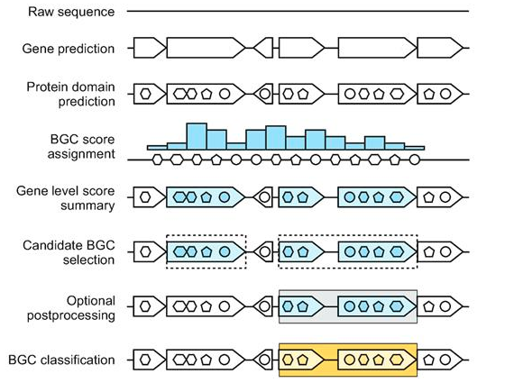
Biosynthetic Gene Clusters
Annotation
Biosynthetic gene clusters (BGCs) are a locally clustered group of two or more genes that together encode a biosynthetic pathway for the production of a secondary metabolite.
Classes of BGCs:
peptide synthetases (NRPS)
polyketide synthases (PKS)
bacteriocins

Slide 42

Biosynthetic Gene Clusters
Annotation
Minimum Information about a Biosynthetic Gene cluster (MIBiG):
facilitate consistent and systematic deposition and retrieval of data on biosynthetic gene clusters

Slide 43
Overview
4. Assembly – free taxonomic profiling and annotation

Slide 44

Assembly-free approach
Why?
speed up computation – assembly methods take a long time
make it possible to profile low-abundance organisms that cannot be assembled de novo – but database dependent
might have improved sensitivity
can answer questions about presence/absence

Slide 45

Assembly-free approach: taxonomy

Slide 46

Assembly-free approach: taxonomy
(http://huttenhower.sph.harvard.edu/metaphlan/)
- 2,887 genomes available from the Integrated Microbial Genomes (IMG) system – 2 million potential markers
mOTUs,
MetaPhlAN

Slide 47


Assembly-free approach: taxonomy
(https://ccb.jhu.edu/software/kraken2/)
Kraken2,
MGmapper
KmerFinder
(https://cge.cbs.dtu.dk/services/KmerFinder/)

Slide 48



Assembly-free approach: function
Local pairwise alignment and/or multiple alignment

Slide 49
Conclusion

Slide 50


Illumina/ONT/Pacbio – Benchmarking Nov 2022
https://www.nature.com/articles/s41597-022-01762-z

Slide 51


Snakemake

Slide 52


Snakemake
Create rules
Install dependencies automatically

Slide 53
Atlas workflow
Sample1
Sample2 Sample
QC
Assembly
Gene prediction
Genes
Genes
Genes
Unique Gene catalog
Annotation
Quantification

Slide 54















Metagenome-Atlas in detail
Assembly
Quantification
ATLAS
Binning
Annotation
Clostridiaceae nov.
A. muciniphila
Kieser et al. 2020

Slide 55



Quality report

Slide 56
2. Assembly
Uses metaSpades or megahit
Pre-processing
Error correction
Paired-end merging (pre-assembly)
Hybrid assembly supported

Slide 57


Assembly report
N genes
Total bp
N contigs

Slide 58
3 Binning
Single-sample / Cross mapping:
Metabat2
Maxbin2
Co-Binning
Vamb
SemiBin

Slide 59






Co-abundance
Option 1: Single-sample assembly/Binnig
Sample 1
MAGs Set 1
Sample 2
MAGs Set 2

Slide 60

Co-abundance
Option 2: Cross mapping
Sample 1
MAGs Set 1
Sample 2
MAGs Set 2

Slide 61




Co-abundance
Option 3:Co-binning
MAGs Set 1
Sample 1
Sample 2
MAGs Set 2

Slide 62
Atlas uses the same tools as large- scale studies on the Human microbiome
 | CIBO | EBI | JGI | ATLAS
 | Pasolli et al. 2019 | Almeida et al. 2019 | Nayfach et al. 2019 | Kieser et al. 2020
Assembly | metaSpades Megahit
Binning | Metabat | Metabat | Metabat Maxbin Concoct DASTool | Metabat Maxbin DASTool VAMB SemiBin
Quality estimation | CheckM

Slide 63






De-replication
Sample 1
Sample 2
Sample 3
Sample 1

Slide 64


Average nucleotide Identity (ANI)

Slide 65



95% ANI used as species threshold
ANI
Jain et al. 2018

Slide 66

Taxonomic annotation
Genome Taxonomy database (GTDB)

Slide 67






Pathway inference
Metabolites
Enzyme 1
MAG 001 | MAG002
Enzyme 1 Enzyme 2 | Enzyme 1 Enzyme 2 Enzyme 4
✗ | ✓
Enzyme 2
Enzyme 3
Enzyme 4
DRAM

Slide 68

Pathway inference
Metabolites
Enzyme 1
MAG 001 | MAG002
Enzyme 1 Enzyme 2 | Enzyme 1 Enzyme 2 Enzyme 4
✗ | ✓
Enzyme 2
Enzyme 3
Enzyme 4
DRAM

Slide 69











Quantification
reads
Unique MAGs
BBmap

Slide 70

What is the abundance of a genome?
Median coverage
-> Relative abundance of organisms
Genome

Slide 71
Tutorial
Bash commands cheat sheet
pwd
– show the path to the current directory, check where you are
cd <dir>
– go into this directory
cd ..
– exit this directory/go to the previous directory
ls
– check the contents of the directory
ls -alt
– check the contents of the directory but also file sizes/date of creation/last author
cat <file>
– show the contents of the file
head <file>
– show only the 10 first lines of a file
tail <file>
– show only the 10 last lines of a file
grep <pattern> <file>
– find a pattern/phrase/word in a file
cp <file1> <file2>
– copy one file into another file
mv <file1 <file2>
– rename a file
Time to get some work done! Lets go back to https://gitlab.bfabric.org/genomics-courses/bio638_2024_june

Slide 72

Relative abundance

Slide 73

CLR

Slide 74
CLR vs relative abundance
Key Differences
Relative Abundance: Proportions that indicate the share of each component within a sample.
CLR Transformation: Log-transformed values that make the data more suitable for multivariate analysis, dealing with the compositional nature of the data.

